Slide 1
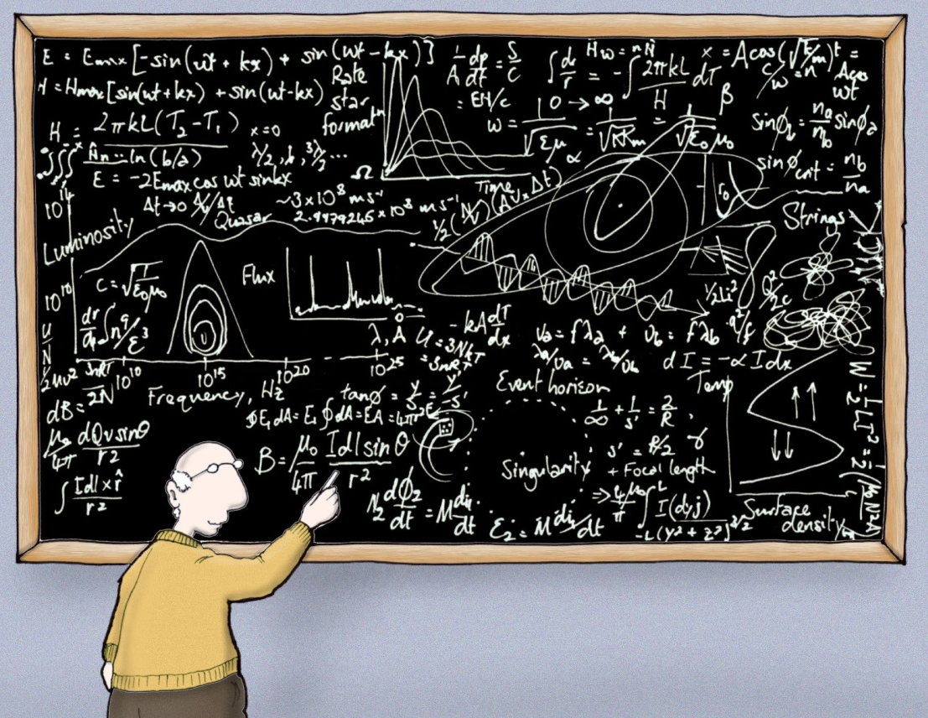
What makes a good talk?
© Nick Kim, CSL Cartoonstock
Used with Permission
Astrophysics made simple
Nadya Mason, Celia M. Elliott, Jessie Shelton
Department of Physics
University of Illinois
© Board of Trustees of the University of Illinois
All rights reserved
With thanks to Brian DeMarco for useful suggestions
Notes:
One of our goals for this class is not only to teach you how to present good talks, but also how to listen to them.
A good communicator recognizes the three major constraints on speakers and plans his talk with them in mind:
Who is the audience? What is their level of expertise? How motivated are they to listen? What is likely to confuse or bore them?
What is the purpose of the talk? To present new results? To inform? To solicit feedback on a new idea? To entertain? To get a job?
How much time has been allotted? It takes about 5–7 minutes to adequately motivate, explain, and summarize one main point in an oral talk. A speaker cannot cover six main points in a 10-min. APS-style presentation, no matter how fast he talks.
As you listen to a talk, ask yourself how well the speaker planned for these three constraints.

Slide 2

Listening to talks and evaluating them
critically will make you a better speaker
Physicist who
never learned
to give good talks
Will work
equations
for food
Learning to give effective talks will have enormous benefits for your future career success, whatever you path you pursue
Notes:
Giving good talks is a skill.
And like any other skill, it requires learning techniques, practicing them, getting feedback, and listening to a lot of talks so that you learn to recognize excellence and emulate it.

Slide 3
What makes a good talk?
Did you learn something interesting?
- Talk should be structured well/pedagogical
- Talk should establish the Why, How, What, and Conclusion
Were you engaged?
- Talk should be targeted to specific audience
- Talk should have good presentation and delivery
Notes:
If you didn’t like a talk, don’t assume it’s “your problem.” There is a surprising universality to good or bad talks.
There are very few boring topics. I’ve seen great talks on the smallest results. And terrible talks on really exciting research.

Slide 4
Learning something interesting
• What are you learning: how clearly does the speaker establish their point?
• Why should you believe it? How well does the speaker support their claims?
  • Did the speaker clearly explain the logic behind their results?
  • Are the plots and data clear and are there references?
• Why should you care? How well does the speaker convey the importance of the results and the bigger picture they fit into?
Structure: Why, How, What, Conclusions
Notes:
The why, how, what, and conclusions

Slide 5

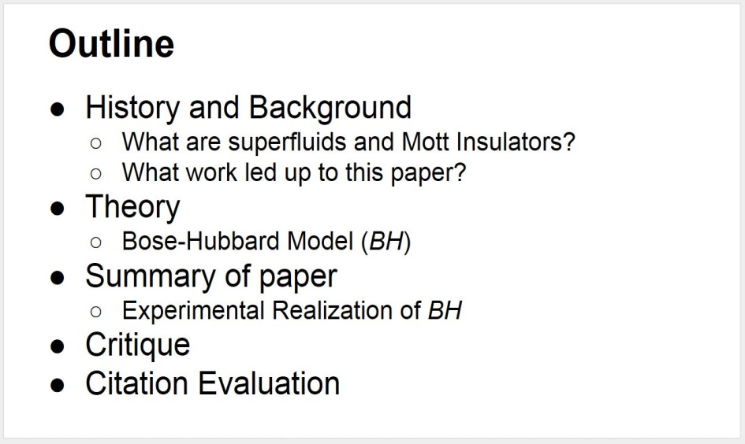
The important points should be previewed at the beginning of the talk
Some techniques to look out for in a good talk …
Adhere to the speaker’s “Rule of 3”:
  tell ’em what you’re going to tell ’em
  tell ’em
  tell ’em what you told ’em
An outline slide can be used for longer talks
Example from a PHYS 596 journal club talk
Notes:
Unlike printed materials, where we can flip back and reread something if we need to understand it before proceeding, we cannot “rewind” an oral talk. Good speakers anticipate this need and tell you the important points more than once.
Common advice to speakers is to tell the audience your important points three times:
Tell them what you’re going to tell them (preview).
Tell them (body of the talk).
Tell them what you told them (summary at the end).
Take it from a mother, telling somebody something important three times is not overkill.

Slide 6
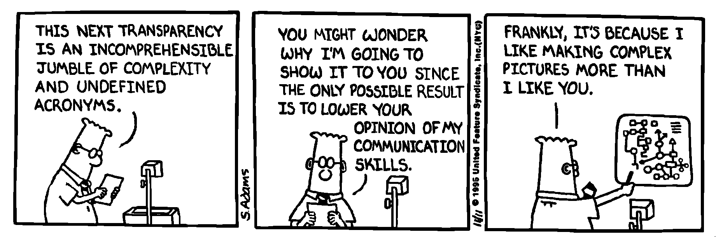
The important points (IPs) should be clear
Used with permission
Scientificus physicus
Was the terminology and level of detail appropriate for the audience?
Did the speaker emphasize IPs and explain why they are important?
Was the talk logically structured around the IPs?
Were figures used to make IPs memorable?
Notes:
Every aspect of a talk should be evaluated in light of the overarching goal for giving the talk: How well does this aspect (the title, the appearance of the slides, the structure of the talk, the language, the figures, the summary) help my audience understand the important points that I’m trying to communicate?

Slide 7
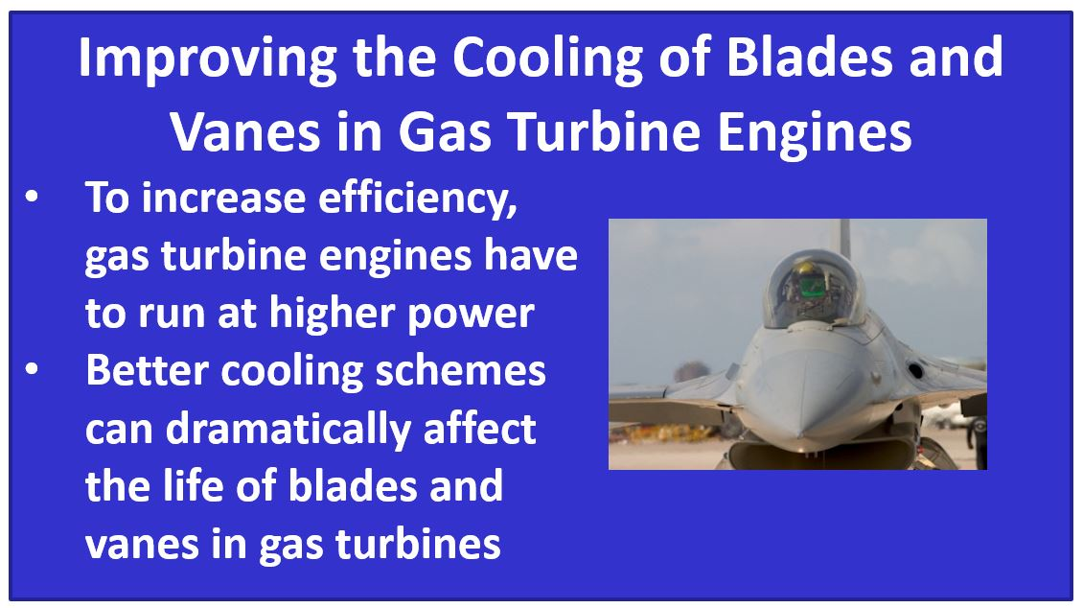
Figures inform, clarify, and give evidence for important points
eye candy
Notes:
Most people remember images much longer and more clearly than they remember words. Every illustration shown in a talk should be directly related to one of the speaker’s important points and should explain, amplify, or clarify it.
If somebody else’s figure has been used, the speaker should at a minimum give credit for it and perhaps provide a URL or bibliographic reference for where the original may be found.
Another tip for ALL figures—a photograph or drawing of something should include some sort of visual clue to its scale. The audience may have no idea if the apparatus shown below is something that sits on a tabletop or has to be hauled around on a truck.

Slide 8
Graphs and tables are kept simple
Women in Top-Ranked Physics Ph.D. Programs (1998)
Regrettably, does represent actual data,
but we’ve improved substantially since 1998
Was their relation to IPs
clear and immediately
obvious?
Illustration only, does not represent actual data
Notes:
The example on the left shows how a plot can quickly show a trend or reveal an underlying relationship. The actual numerical data are not as important as the slope of the line.
Note also that this plot has axis labels and tick marks that are large enough to be seen by somebody sitting in the back row.
The example on the right shows how tabular data can be presented in a form that people listening to a talk can immediately process. Highlighting the relevant line conveys the main idea—that Illinois was ranked far down the list. The audience probably doesn’t care that Illinois’s score was 4.66 and Harvard’s was 4.91; they care that Illinois is ranked toward the bottom of its peers, and its percent of women was in single digits. (We’ve improved substantially since 1998.)

Slide 9


Equations are tied to important points and are needed to understand them
Did the speaker…
  Define terms?
  Talk through the equation step by step?
  Explain relevance?
  Make equations large enough to be easily read?
The talk should build up to technical results. In general, too much technical information can be exhausting and offputting; but too little can be unconvincing or facile
Notes:
Equations should not be sprinkled thoughtlessly through talks; they should be used only when they’re essential to understanding one of the speaker’s key points. It’s often helpful to substitute words for blocks of standard terms in equations; words are usually easier for the audience to process.
Here’s an example:
Γ $$ (phase space) × M_{ij}

Slide 10
Slide design is a critical part of any presentation
• Are figures easily legible?
• Can you read the axes? Do you understand what’s being
plotted?
• Is it easy to identify the physics point being made, or is
there a lot of extraneous information?
• Are the slides visually confusing?
• Are the slides visually distracting?

Slide 11
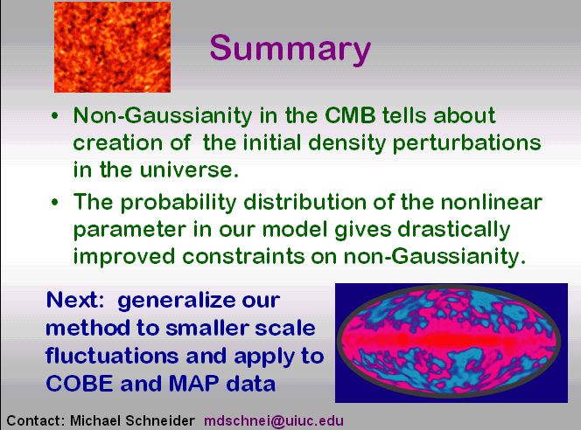
The important points are reiterated at the end of the talk (“Rule of 3”)
Recap key results
Reiterate principal conclusions
Notes:
The speaker should provide a summary slide that recaps key points and cues the audience that the Q&A is about to start. The summary slide should help people review what they’ve learned and remind them of questions they want to ask.

Slide 12
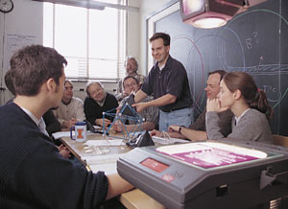
A successful talk must be tailored for the listeners
Engaging a listener …
Good talks are presented at a level appropriate for the audience
One needs different presentations for:
  Group meeting
  Colloquium talk
  Seminar talk
  Report to a boss, customer, or
  funder
  Job interview
  Club or volunteer group
Notes:
It’s ok for a talk to entertain and educate. 10 minute attention span. Adding cartoons to general audience talk –
A good communicator recognizes the three major constraints on speakers and plans his talk with them in mind:
Who is the audience? What is their level of expertise? How motivated are they to listen? What is likely to confuse or bore them?
What is the purpose of the talk? To present new results? To inform? To solicit feedback on a new idea? To entertain? To get a job?
How much time has been allotted? It takes about 5–7 minutes to adequately motivate, explain, and summarize one main point in an oral talk. A speaker cannot cover six main points in a 10-min. APS-style presentation, no matter how fast he talks.
As you listen to a talk, ask yourself how well the speaker planned for these three constraints.

Slide 13

The speaker maintains a uniform pace throughout the talk
No skipping slides or rushing to cover half the talk in the last 5 min
Notes:
A speaker should maintain an even pace throughout the talk, not rush through the last 10 slides in a panic because he failed to rehearse and check his timing.

Slide 14
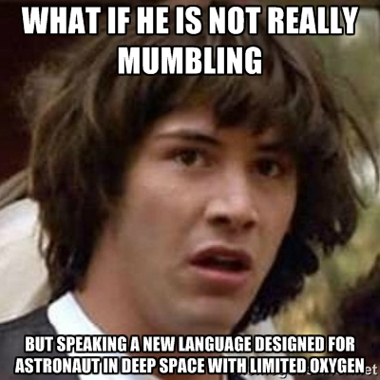
The speaker enunciates words clearly and distinctly and speaks in a conversational tone of voice
http://memegenerator.net/instance/60578054
No mumbling
No monotone
No sing-song intonation
Notes:
Even if you’re a native English speaker, remember that many members of your audience may not be. Slow down and pronounce every word distinctly.
If you’re a non-native English speaker, slow down and pronounce every word distinctly.
Factor the need to speak slowly and distinctly into your calculations of how much material you can cover in your allotted time.

Slide 15

Questions are handled appropriately
Did the speaker:
  Ask for questions at the end of the talk?
  Repeat a question so everyone in the room heard it?
  Treat questioners with
  respect?
  Respond appropriately
  if he didn’t know the
  answer?
Notes:
Learning how to handle questions is an important skill for all speakers. Later on in this class we’ll explore strategies for you to use to master questions.

Slide 16
No annoying mannerisms
Pacing, arm-waving, distracting gestures
Verbal fillers, “and, um, like…you know”
Jingling keys or coins
Fiddling with the microphone
Forgetting to TURN OFF the damned cell phone or other electronica
Turning away from the audience and reading off the screen
Laser-pointer acrobatics
Notes:
Did the speaker have any annoying mannerisms that made it hard for you to pay attention? Make note of them and resolve to correct your own bad habits.

Slide 17


To recap…
Did the talk meet the needs
and expectations of the audience?
Did the speaker cover an appropriate amount of material?
Did the talk have a clear beginning, middle, and end?
Were the main points clear and memorable?
Did the talk seem conversational but polished?
Did the speaker finish on time?!
cmelliot@illinois.edu
http://physics.illinois.edu/people/Celia/
Notes:
NOTES:

Slide 18
Learn to evaluate talks analytically and critically—think about the delivery as well as the scientific content
Some practical tips:
• All talks start with the abstract — so read it before you go
• Take notes — preferably on paper
  • do not let yourself check your phone
• Identify details as well as larger issues
  What was effective?
  What could have been done better?
  What do I want to emulate?
Notes:
Excellent advice from Professor DeMarco:
“Few people take the time to evaluate a talk that they have heard. Doing so is really the key to learning how to give a better talk.
“If you want to become a better speaker, after giving or listening to a talk *every time*:
Think: What was ineffective about the talk? What are a few things that could be improved? Be specific. Try to identify details and larger issues.
Think: What was effective? Find three things. Be specific. Try to identify details and larger issues.”

